Slide 1
Bank Domain PPT

Slide 2
Banking flow
1. Login flow
2. new user registration
3. add/update/delete beneficiary
4. transfer the fund
5. personal details
6. Account details
7. Account statements
8. Nominee Details
9. Bills and Recharge
10. debit card details
11. New Beneficiary for visa card payments
12. Signoff
13.feedback

Slide 3
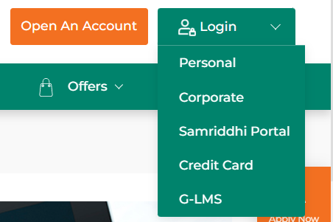
1.Login flow
Open your browser and type your online net banking e.g. IDBI net banking .
As per your account you can select login type. Select personal.

Slide 4
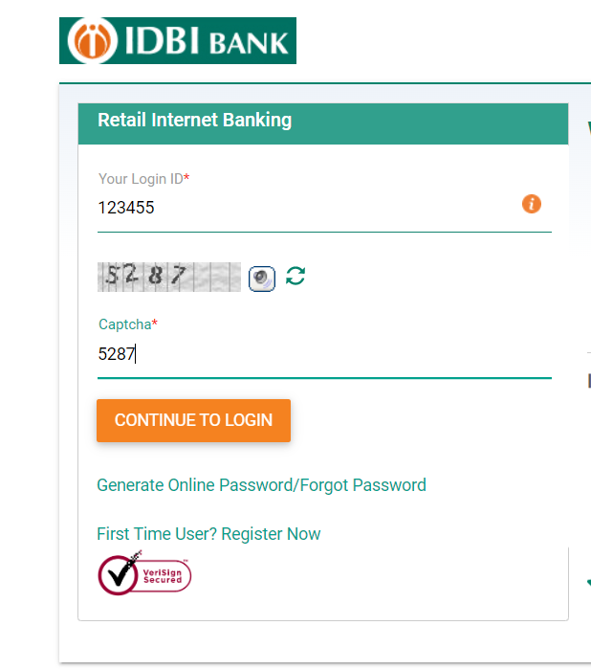
Personal login page looks like as below image
Here we have to enter login id /customer ID and Captcha.
Bank provide the Login Id/customer Id at the time of account creation.
If you register first time then click on first time user

Slide 5
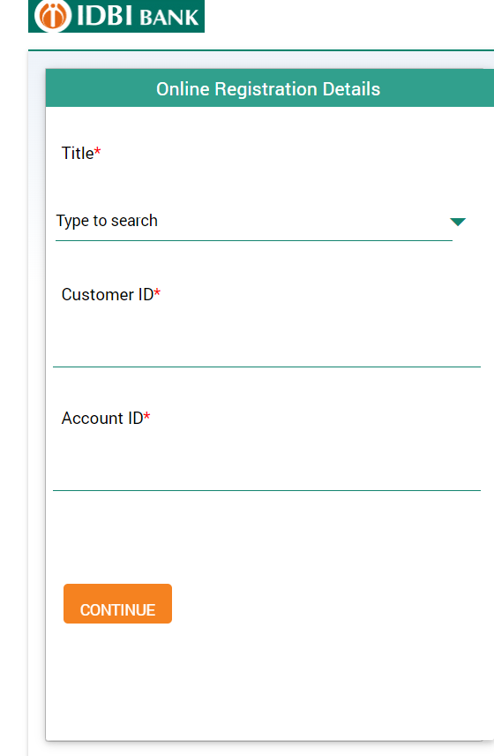
2. new user registration
Hear we have to enter the customer id and account Id and click on continue, both Id bank provide to you at the time of account creation.

Slide 6
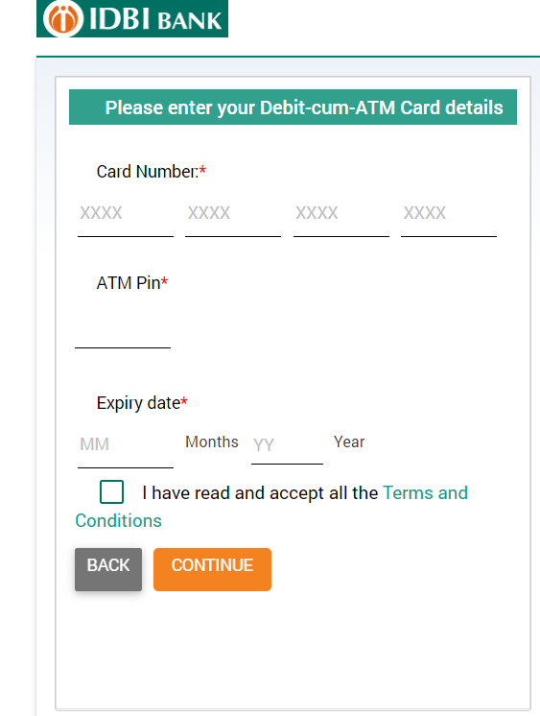
Enter the Debit card details

Slide 7
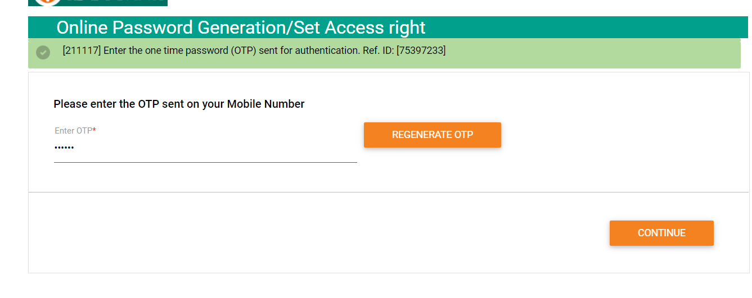
After validation
After validating the all debit card details we will get the OTP to your register mobile number, then your authentication will be completed. after that you will become ready to create the login password and transaction password as well.

Slide 8
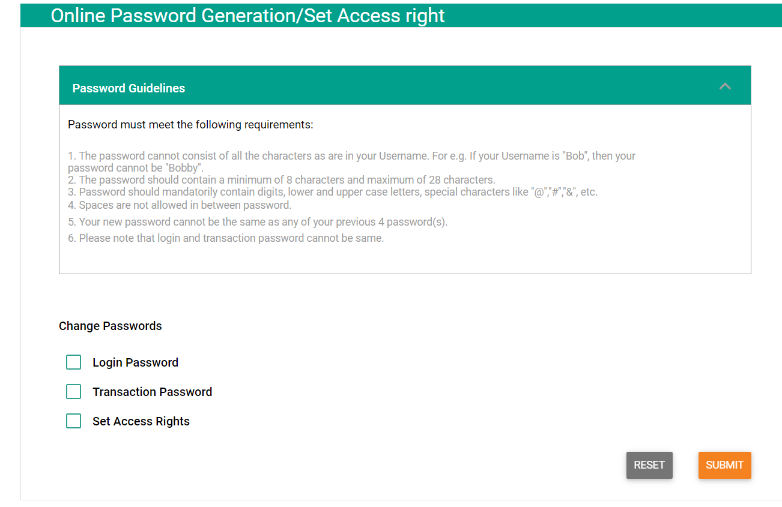
Password setting
Hear you can set the new password for login and transaction as well also you can set access right.
After successfully setting the password go to login window and enter the customer id and login password.

Slide 9
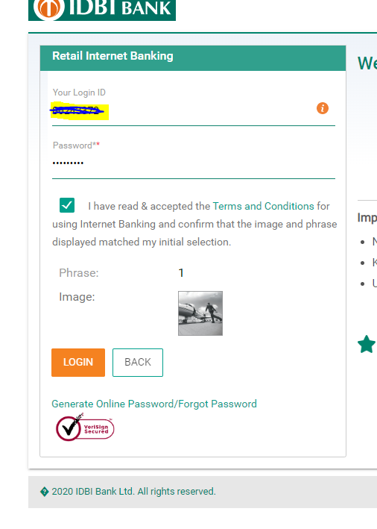
Login window
After entering the correct Id and password then click on the login button you can see the login page.

Slide 10
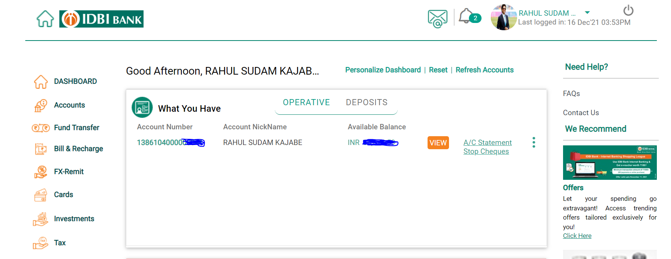
Login page

Slide 11
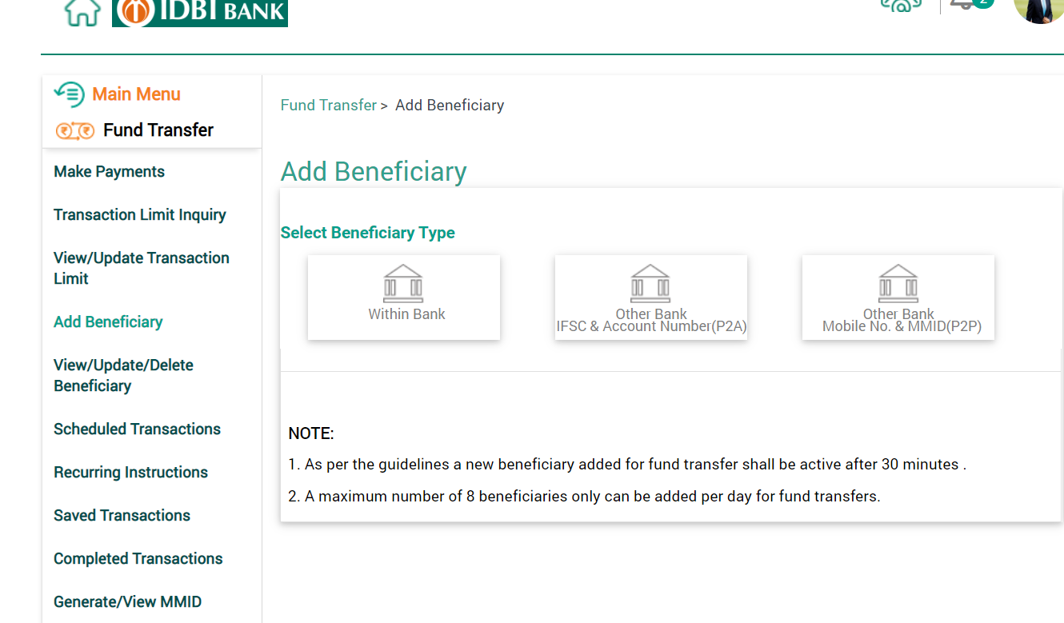
3. add/update/delete beneficiary
Hear you can add new beneficiary to transfer the fund/amount.
It may be within the bank or outside the bank, you can select the beneficiary type and then enter the beneficiary details.

Slide 12
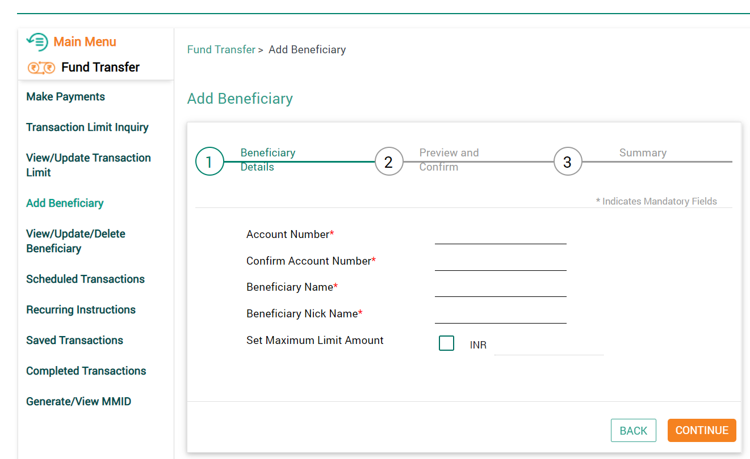
beneficiary details
After entering the beneficiary details account will active after 30 min or 1 hrs depending upon the bank application.

Slide 13
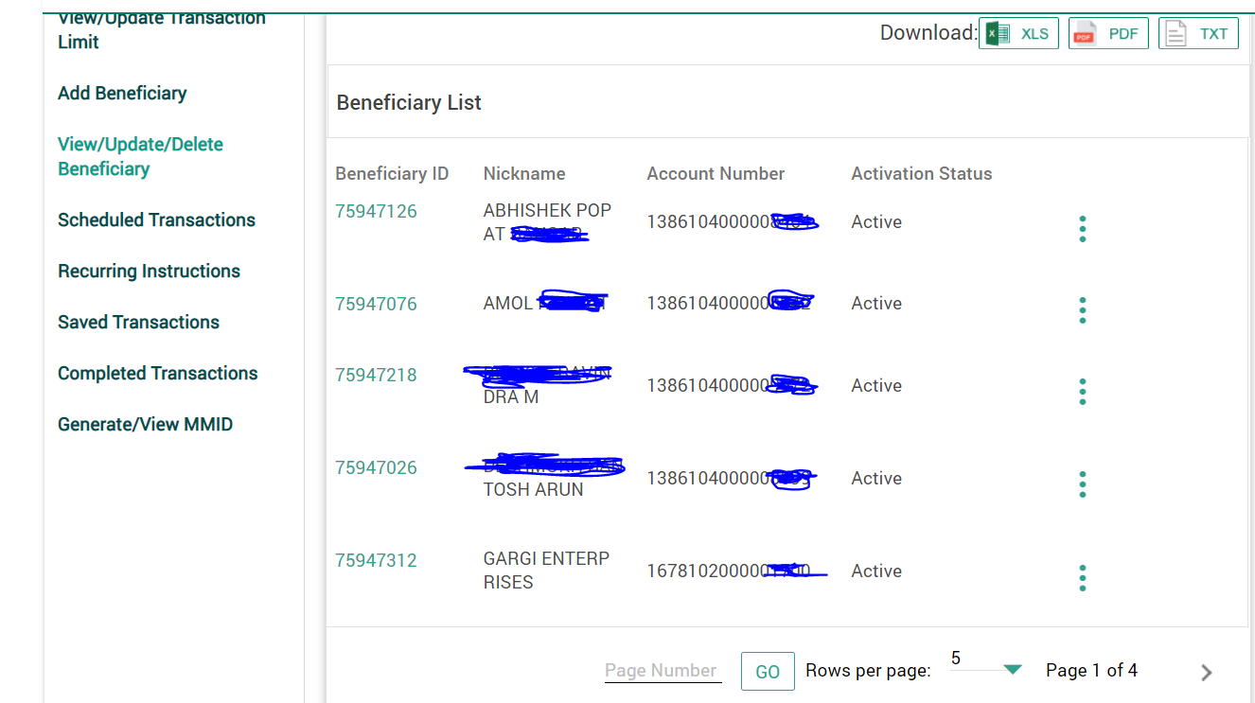
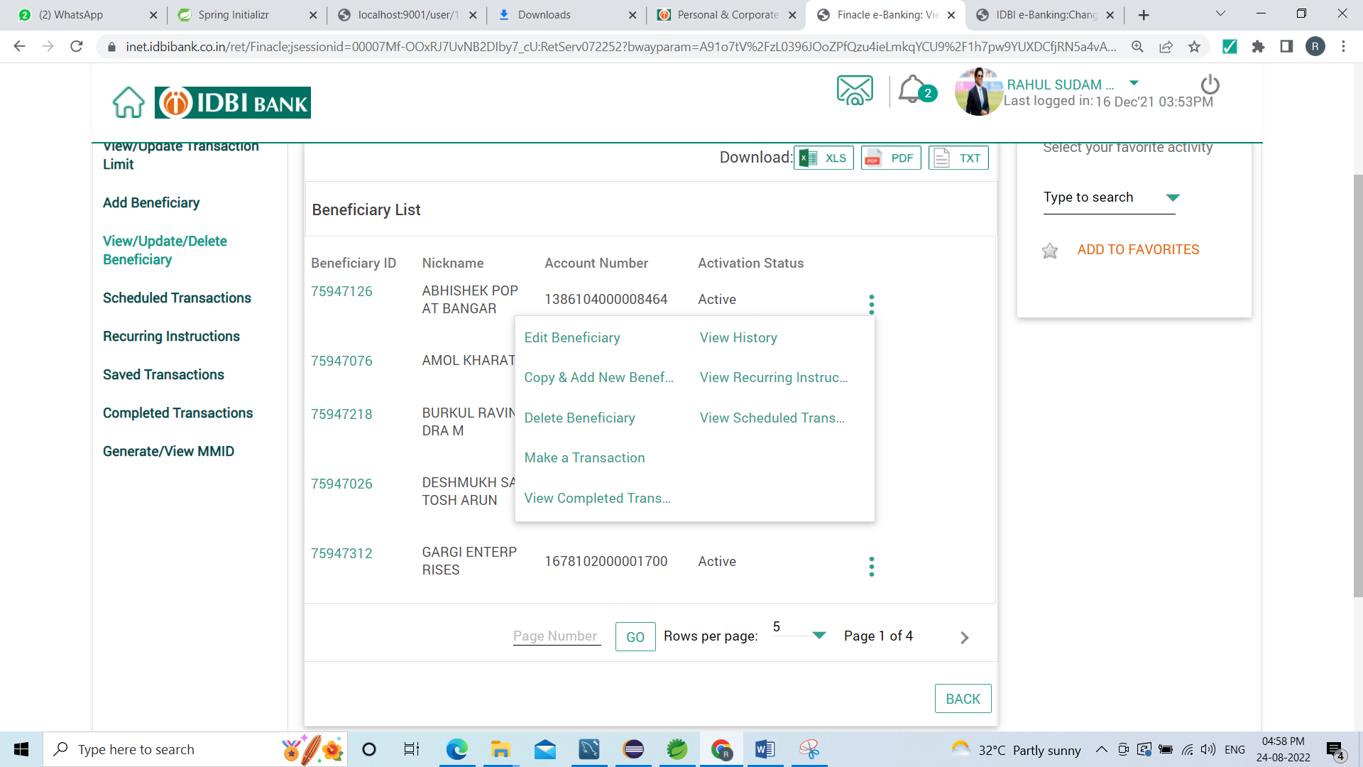
List of beneficiary
Hear you can see the list of beneficiary and also you can perform the update delete and edit operation.by clicking on three dots

Slide 14
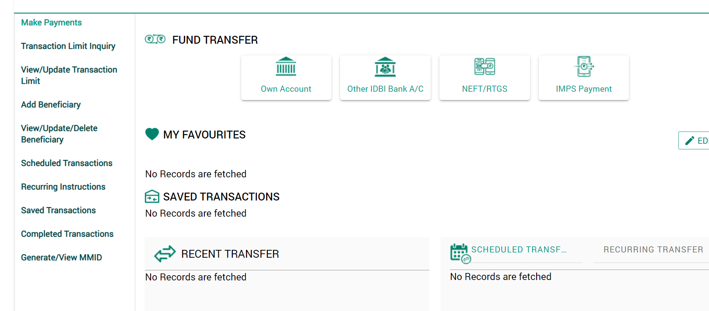
4. transfer the fund
After beneficiary active you can transfer the fund

Slide 15
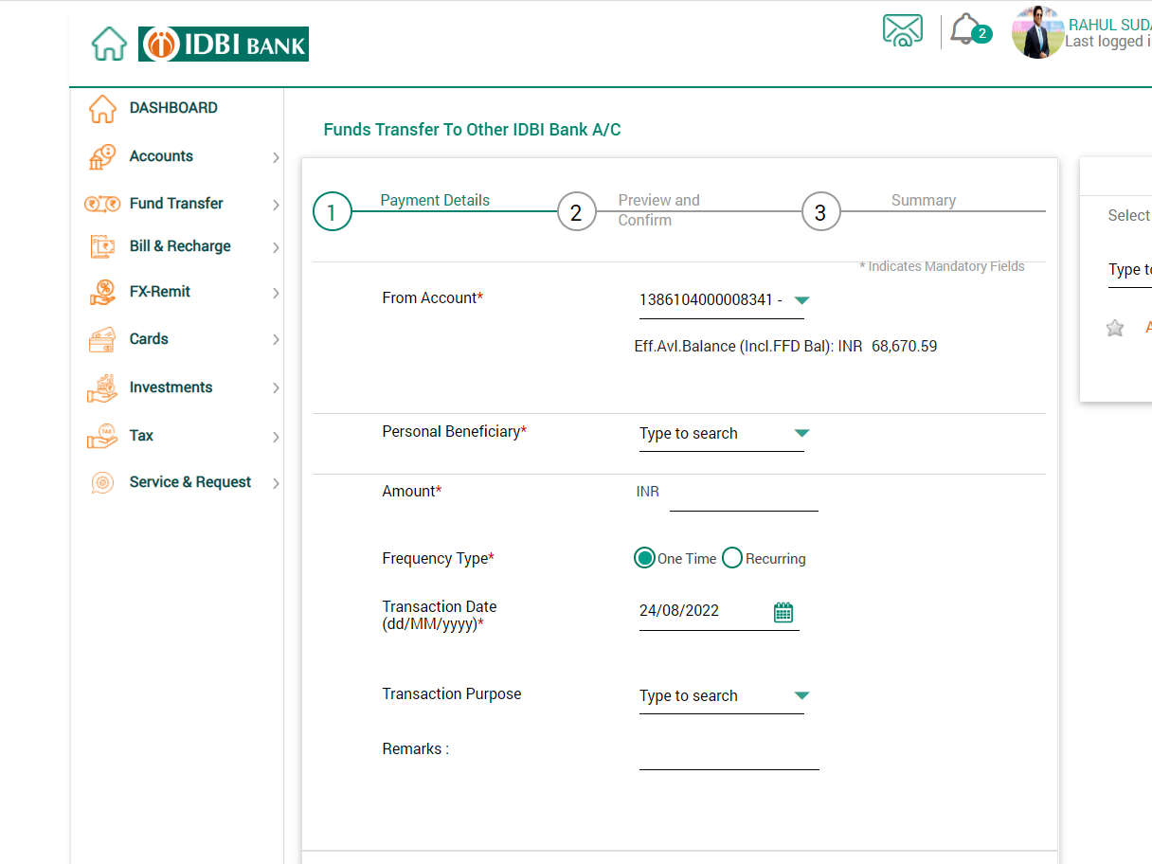
Fund transfer page
For transferring the fund you have to enter the following field then confirm the payment .

Slide 16
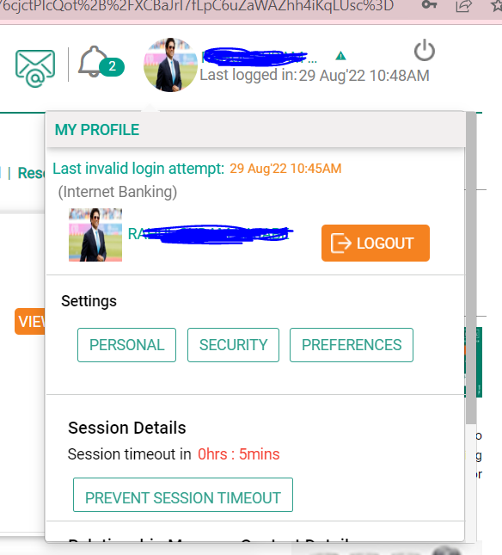
Personal Details
For personal details click on profile we can see below tabs. Then click on personal tab.

Slide 17
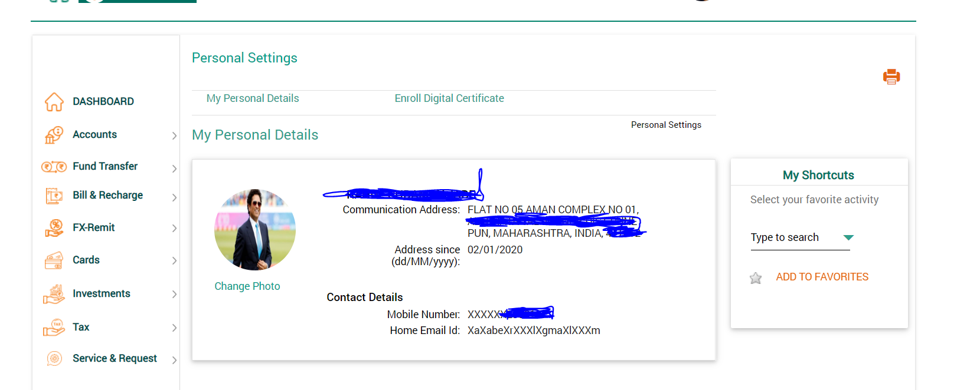
Personal Details field

Slide 18
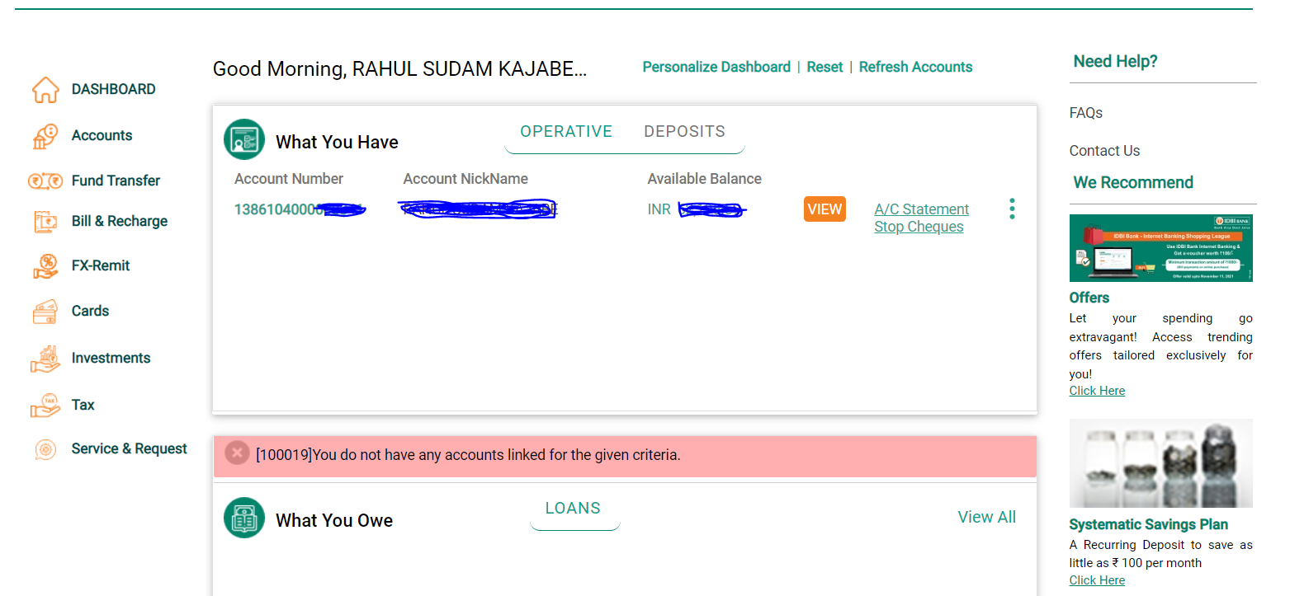
View Details

Slide 19
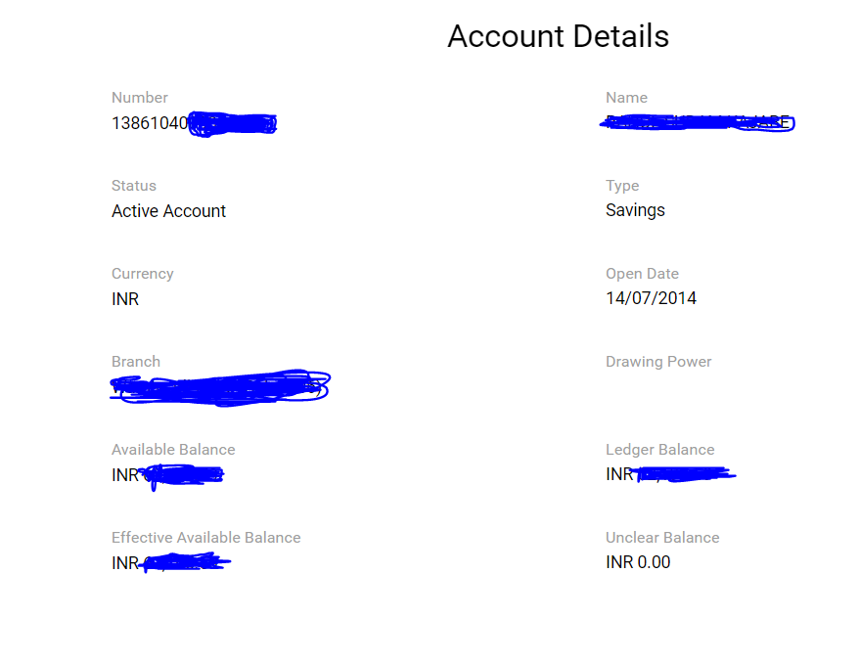
Below are the Account details

Slide 20
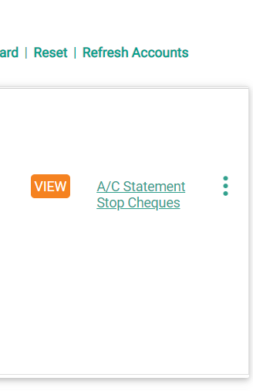
Account statements

Slide 21
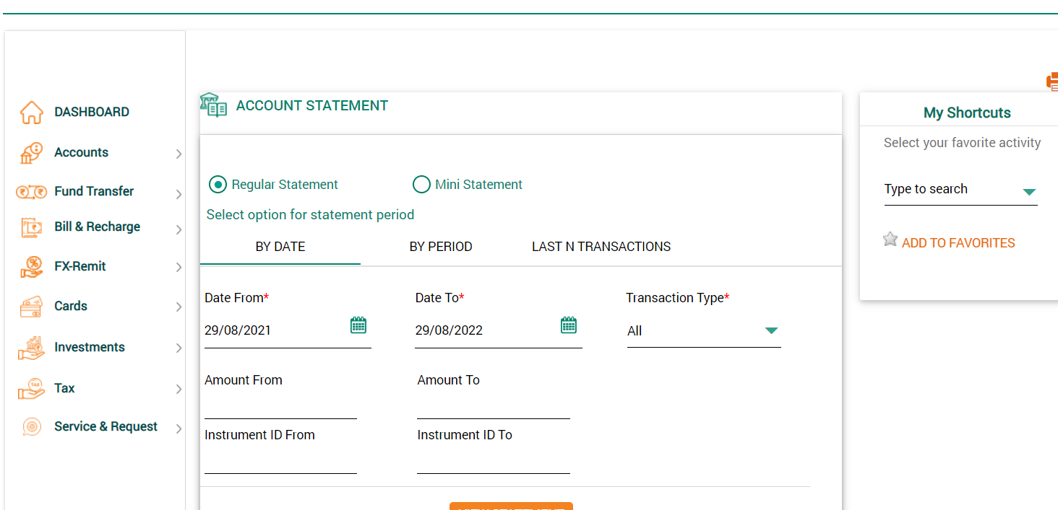
Account statements Regular statement>>as per date selection mini Statement>>for 10 transaction

Slide 22
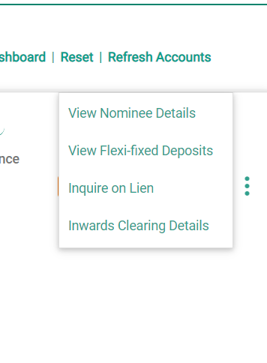
Nominee Details

Slide 23
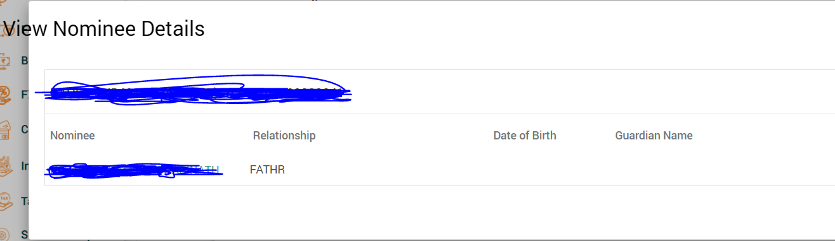
View nominee Details

Slide 24
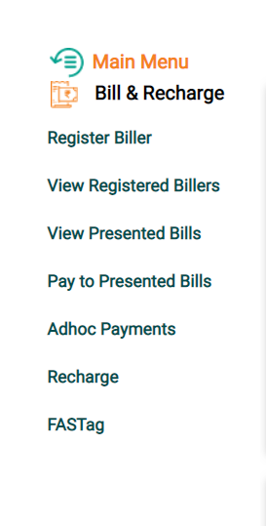
Bills and Recharge

Slide 25
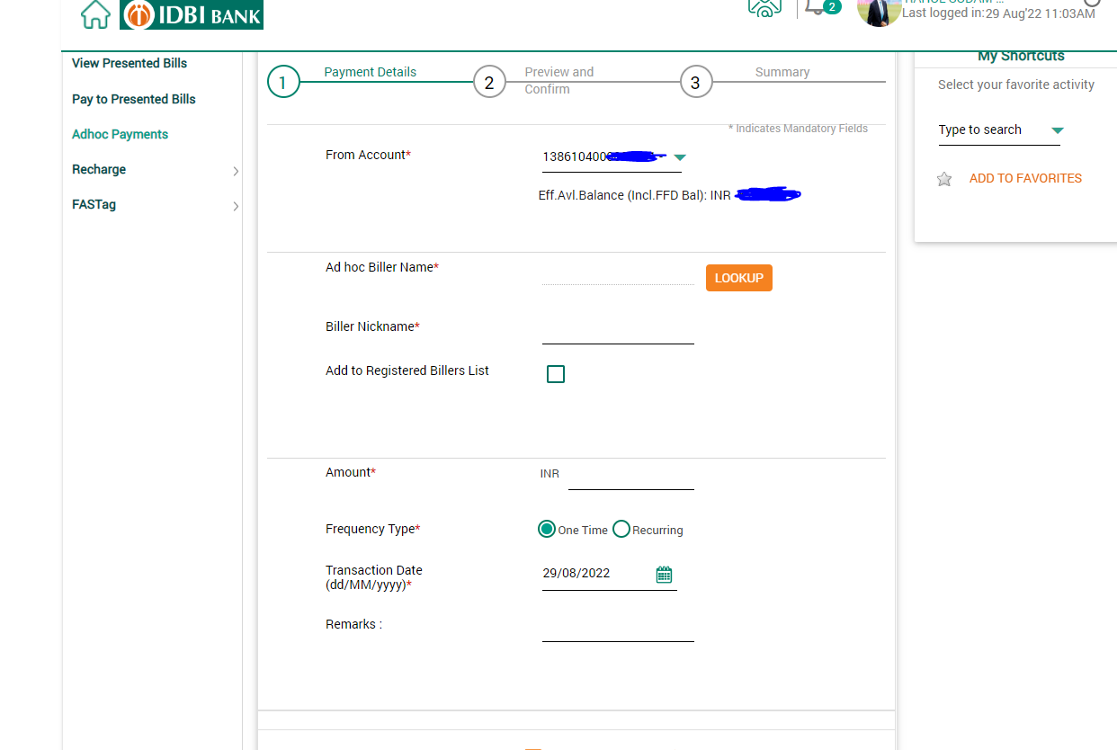
Adoc payments

Slide 26
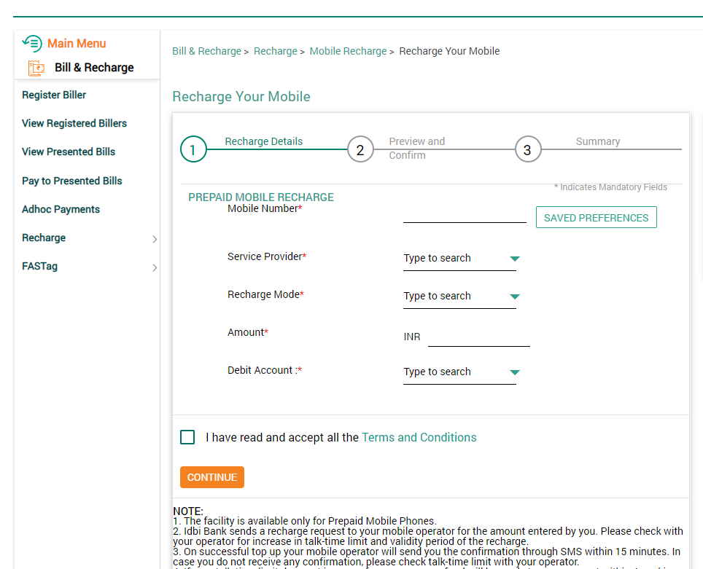
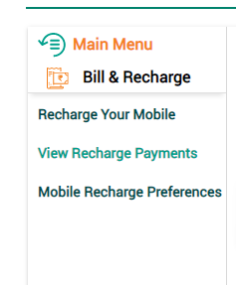
Mobile recharge

Slide 27
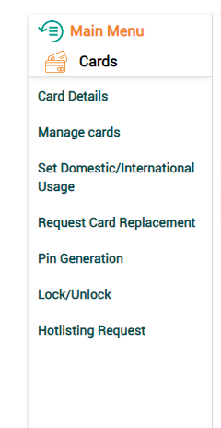
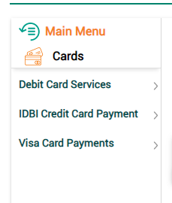
debit card service

Slide 28
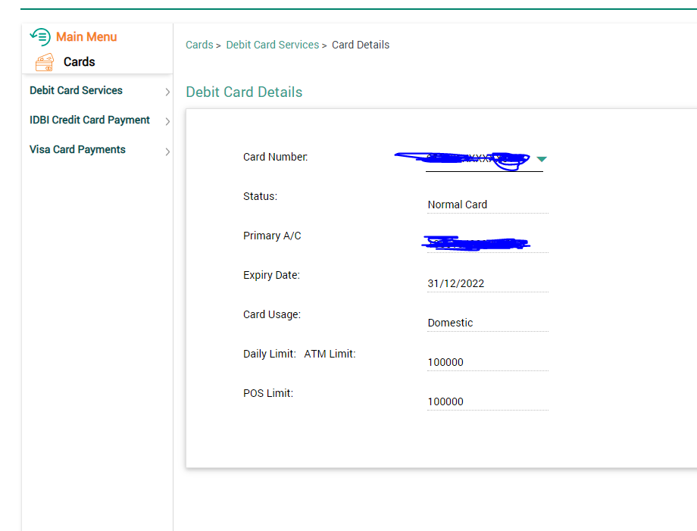
card details

Slide 29
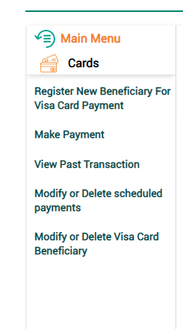
Visa card payments Details

Slide 30
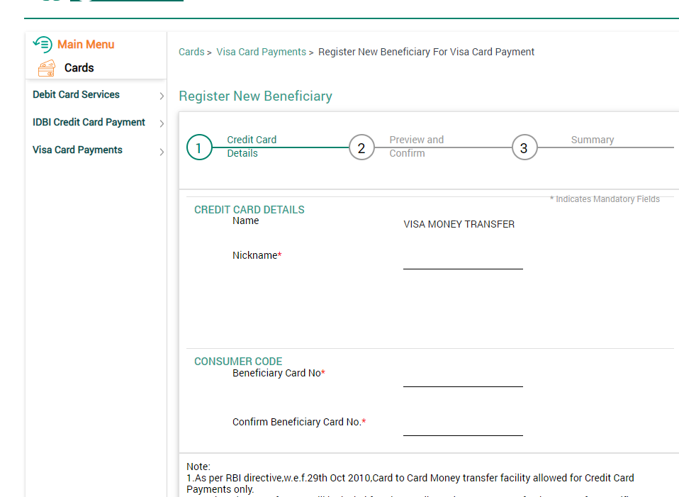
New Beneficiary for visa card payments

Slide 31
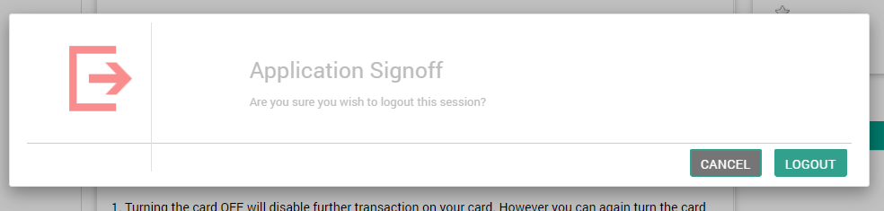
Signoff

Slide 32
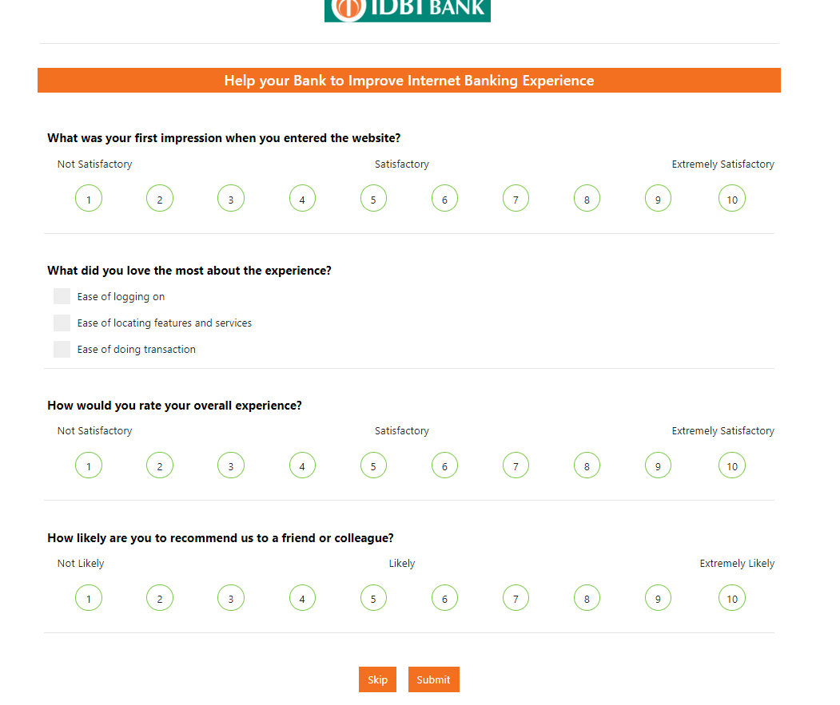
feedback

Slide 33
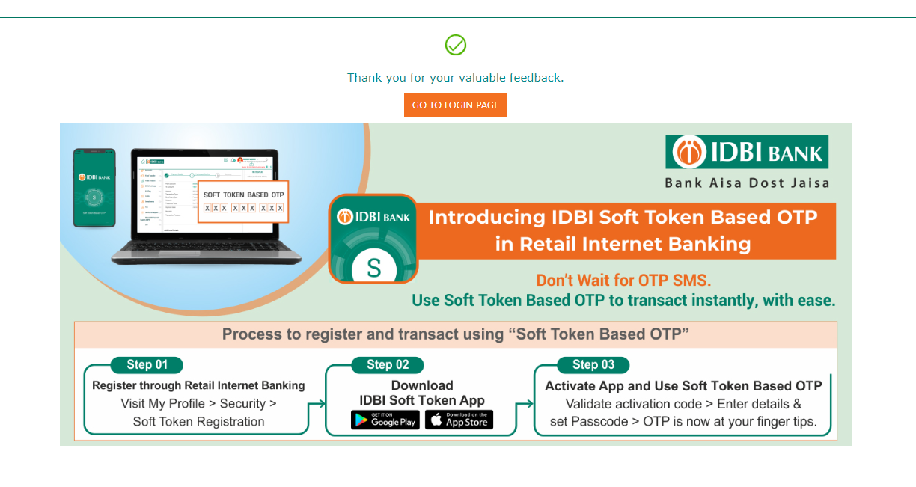
Thank you screen

Slide 34
Thank you

